Slide 1

Regularizing your neural network
Other regularization
methods
deeplearning.ai

Slide 2



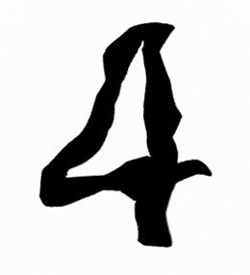
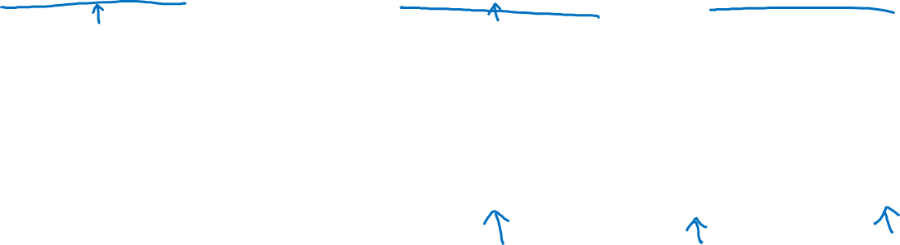
Data augmentation
4

Slide 3
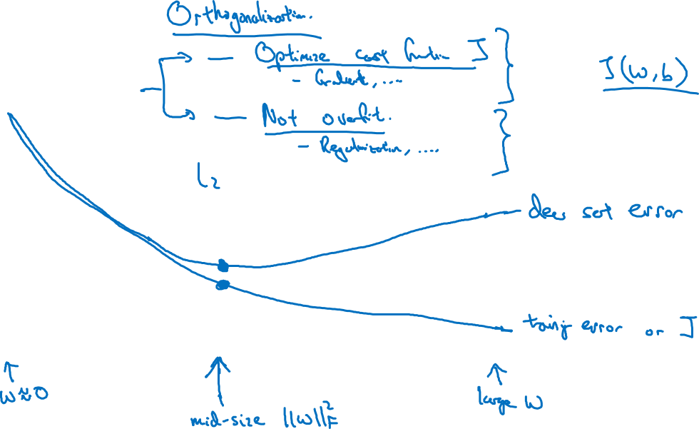
Early stopping
# iterations

